Slide 1
EXCEL WITH YOUR ECONOMIC MODELS IN R

Slide 2
Today’s speakers
Jeroen P Jansen PhD
Precision; Innovation & Value Initiative
Joseph Levy PhD
John Hopkins University
Devin Incerti PhD
Precision; Innovation & Value Initiative

Slide 3
Live Content Slide
When playing as a slideshow, this slide will display live content
Poll: What software do you mostly use for cost-effectiveness analysis?
Notes:
This is a live content slide. When playing this presentation as a slideshow, this slide will be where live content appears. Please leave the following Slide Code tag in place: <cnf>QZNRTGP8ZWM8DASC</cnf>

Slide 4
Live Content Slide
When playing as a slideshow, this slide will display live content
Poll: Do you think R is better for cost-effectiveness modeling and analysis than Excel?
Notes:
This is a live content slide. When playing this presentation as a slideshow, this slide will be where live content appears. Please leave the following Slide Code tag in place: <cnf>XE52AB3BY93EEFEW</cnf>

Slide 5
ationale

Slide 6
Criteria that economic models should strive to meet
Clinical realism
A model should reflect the state of evidence, the current understanding of the disease, and be accepted by clinical experts.
Quantifying decision uncertainty
A model should be capable of quantifying decision uncertainty and informing prioritization of future research.
Transparency and reproducibility
Resources should exist so that a model can be completely understood, reproduced, and pressure tested.
Reusability and adaptability
It should be possible to easily update a model to reflect new clinical evidence or adapt it for a new market, indication, or intervention.
Many of these are unobtainable without the use of modern software
Notes:
Historically, models have been developed with specialized commercial software (such as TreeAge) or more commonly with spreadsheet software (almost always Microsoft Excel). Although these tools may be sufficient for relatively simple analyses, methodological and computational advances now allow for models that are increasingly sophisticated and realistic but cannot be reasonably computed in Excel. Related fields such as statistics, economics, and machine learning utilize many of these advances and consequently make heavy use of modern programming languages such as R, Python, MATLAB, and Julia.¹⁻⁴ Yet, in the context of HTA, there seems to be an ongoing preference among manufactures preparing submissions and reviewers for economic models in Excel.

Slide 7
Common practice – 2-step approach
Input parameter estimation (by means of evidence synthesis) with statistical software
Forward simulation to calculate expected outcomes (e.g. QALYs, costs, NMBs, etc.) with economic model implemented in MS Excel

Slide 8

Plugging in model input parameter estimates

Slide 9
Oncology
Preferred economic model structure: multi-state model
Common practice
Why not this?
Economic model
Partitioned survival model
Economic model
Evidence synthesis
Evidence synthesis
Typical source data: KM curves, hazard ratios
Meta-analysis of baseline hazard function for PFS and OS
Network meta-analysis of (time-varying) hazard ratios for PFS and OS

Slide 10
Quantifying decision uncertainty as a function of parameter uncertainty and structural uncertainty
Notes:
How can we capture multiple model structures with excel

Slide 11
Transparency & reproducibility

Slide 12
Excel-based models

Slide 13
Excel-based models

Slide 14
Where is Waldo

Slide 15
What do we mean with model transparency?
Concept, math
Face validity
Implementation/programming
Open-source, open-access
Familiarity with software?

Slide 16
Alternative
BCEA HEEMOD HESIM …

Slide 17
hesim
http://hesim-dev.github.io/hesim/
Notes:
hesim is an R package for health-economic simulation modeling that is naturally integrated with statistical modeling and provides support for decision analysis. An economic model is constructed by combining statistical models for disease progression, costs, and utilities. As shown in the figure, a typical analysis proceeds in a 3-step process as follows:
Parameterization: An economic model is parameterized by estimating statistical models for disease progression, costs, and utilities using “estimation” datasets, such as extracted data from published studies for a meta-analysis or multi-state survival data from a clinical trial.
Simulation: The statistical models estimated in Step 1 are combined to construct an economic model. For a given model structure, disease progression, QALYs, and costs are simulated from “input data”, based on the target population and treatment strategies of interest.
Decision analysis: Simulated outcomes from Step 2 are used to perform decision analysis using approaches such as cost-effectiveness analysis (CEA) and multi-criteria decision analysis (MCDA).
The entire analysis is inherently Bayesian, as uncertainty in the parameters from the statistical models is propagated throughout the economic model and decision analysis with probabilistic sensitivity analysis (PSA). Furthermore, since the statistical and economic models are integrated, patient heterogeneity can be easily introduced with patient level covariates.

Slide 18
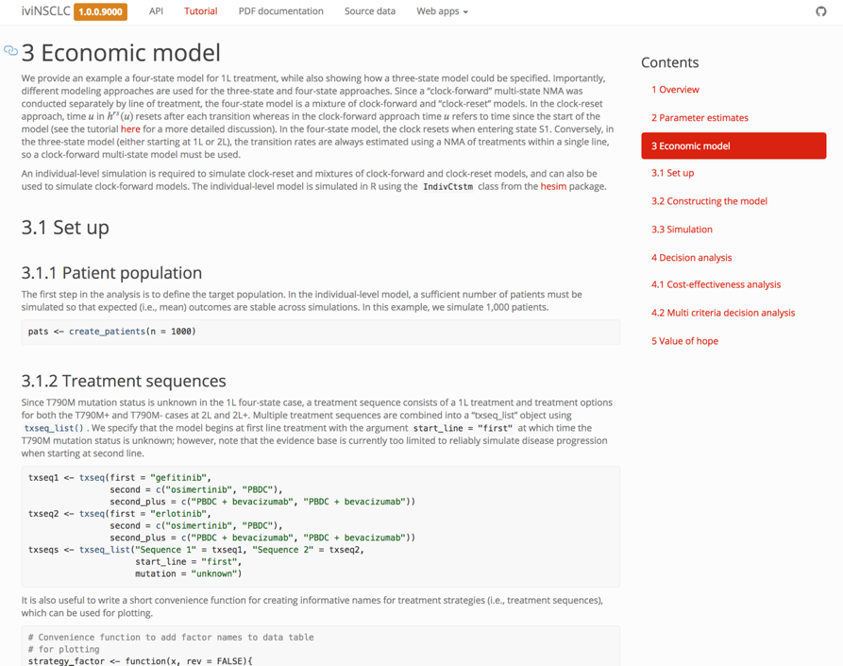
Increasing transparency with reproducible scripts

Slide 19
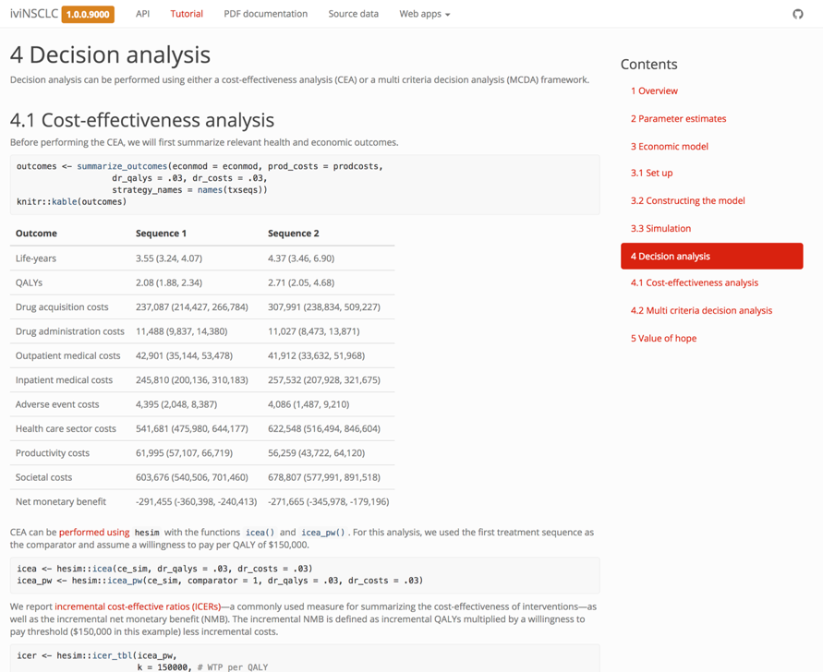
Increasing transparency with reproducible scripts

Slide 20

User friendly interfaces
https://innovationvalueinitiative.github.io/IVI-NSCLC/

Slide 21

User friendly interfaces
https://innovationvalueinitiative.github.io/IVI-NSCLC/

Slide 22

Code testing
Unit tests can be performed to ensure units of source (e.g. functions) produce correct results
Enhance code adaptability because developers can test that modifications or new features do not create unintended errors
R packages (testhat, Runit) facilitate unit testing

Slide 23
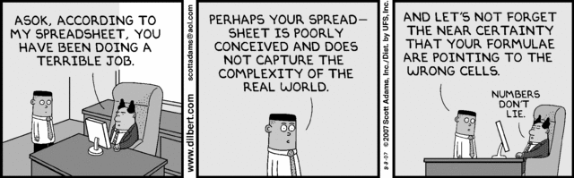
Time to change?

Slide 24
Using for health economic modeling

Slide 25
Modeling in Excel
Excel has been dominant software platform used by modelers forever, especially for HTA submissions
Reasons are not surprising:
(practically) Everyone with a computer has access to Excel
Does not require that you learn a new programming language
Many users consider its “transparency” to be an attribute
With models in Excel, you can follow calculations that are being performed in every single cell of every single worksheet

Slide 26
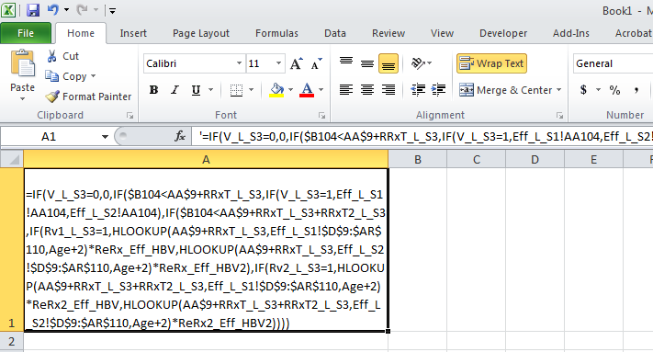
Modeling in Excel
Virtually all textbooks use it
And for simple models, it is transparent and fast to build
However……
Transparent???

Slide 27
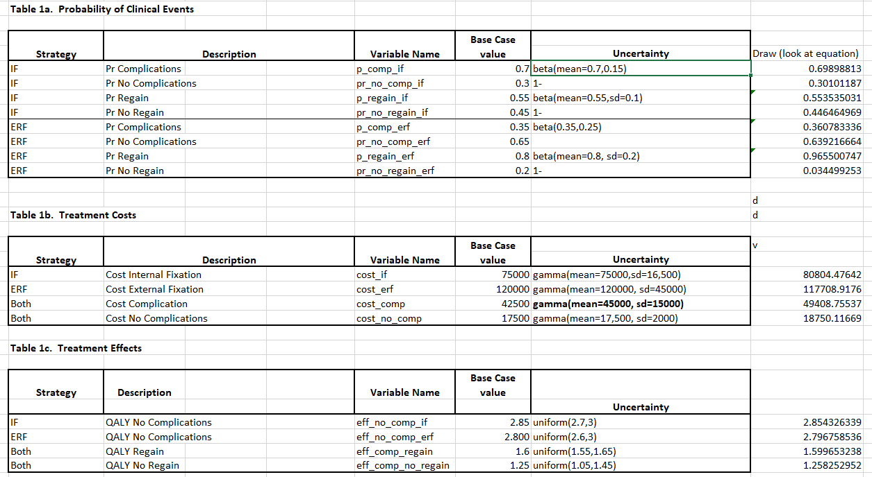

Slide 28
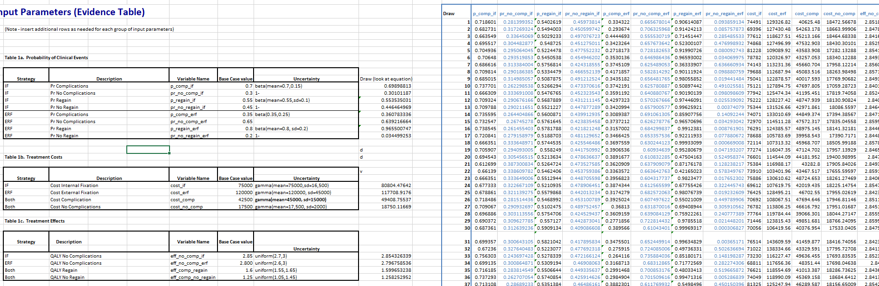

Slide 29
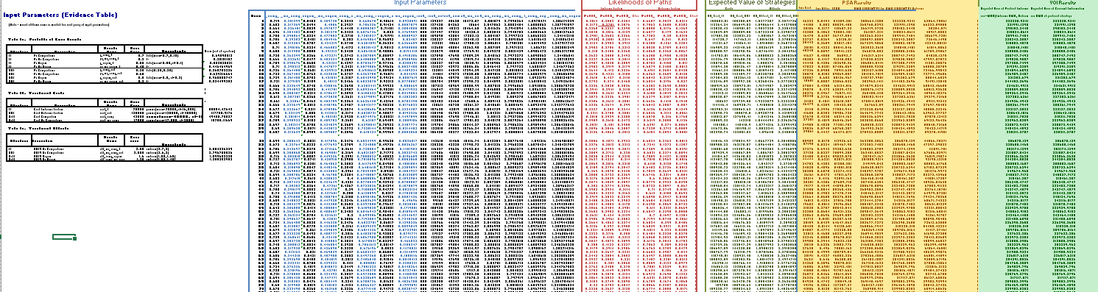

Slide 30
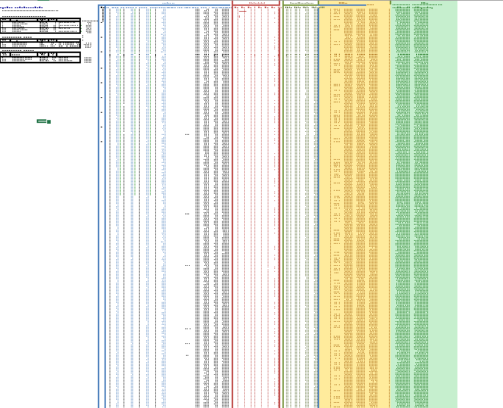

Slide 31
Criticisms
Really hard to check, models can be validated by building second one from scratch, this is rarely done due to budget and time constraints
Complex procedures generally require VBA knowledge
Increasingly more data and other models, inform CEA. Excel cannot do all of these things
Slow performance with large and complex models

Slide 32
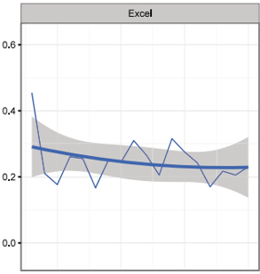
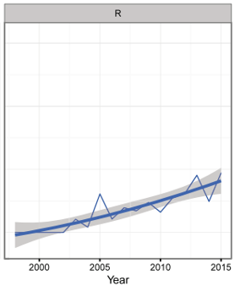
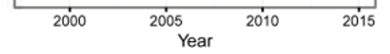

An Overview of R in Health Decision Sciences Jalal et al. (Med Decis Making 2017;37: 735–746)

Slide 33



What is R
Statistical programing language and environment for statistical computing
Totally free to use (open source, user developed packages that are completely transparent)
Very good for regression analysis, hypothesis testing, data management, visualization and cleaning (and many, many other things)
All parts of an analysis can exist in one file (code)
CEA models can be coded from ‘scratch’ using r core or via convenient and improving packages

Slide 34
Programing in R
Everything is an object or function
Code can be highly customized or generalized to suit purposes
Packages are shareable bundles of code, data and documentation that allow for reproducible analysis
Built for statistical analysis, contains may functions relevant for CEA
There are many ways to do the same thing

Slide 35
Programing a Markov model in

Slide 36
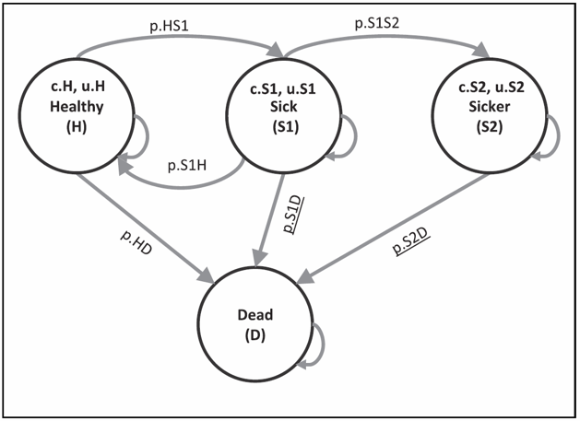
Example: Sick Sicker Markov
Compare Treatment to No Treatment
4 State Model
Treatment Modifies Cost of Sick, Sicker and Utility of Sick
Transitions Probabilities are the Same between treatment groups
Time horizon: 5 years
Adapted from Krijkamp, Eline M., et al. "Microsimulation Modeling for Health Decision Sciences Using R: A Tutorial." Medical Decision Making 38.3 (2018): 400-422.

Slide 37
Example: Sick Sicker Markov
Parameter | No Treat | Treat
p.HS1 p.S1S2 p.S1H p.HDie p.S1Die p.S2Die | 0.15 0.105 0.5 0.005 0.01492512 0.04888987 | 0.15 0.105 0.5 0.005 0.01492512 0.04888987
cost.H cost.S1 cost.S2 | 2000 4000 15000 | 2000+12000 4000+12000 15000+12000
utility.H utility.S1 Utility.S2 | 1 0.75 0.5 | 1 0.95 0.5
Discount Rate | 3% | 3%
Krijkamp, Eline M., et al. "Microsimulation Modeling for Health Decision Sciences Using R: A Tutorial." Medical Decision Making 38.3 (2018): 400-422.

Slide 38
Example: Sick Sicker Markov
Krijkamp, Eline M., et al. "Microsimulation Modeling for Health Decision Sciences Using R: A Tutorial." Medical Decision Making 38.3 (2018): 400-422.

Slide 39
Example: Sick Sicker Markov
Krijkamp, Eline M., et al. "Microsimulation Modeling for Health Decision Sciences Using R: A Tutorial." Medical Decision Making 38.3 (2018): 400-422.

Slide 40
State Occupancy (Matrix Arithmetic)
Define Transition Matrix
> transition_matrix<-matrix(c((1-.15-0.005),.15,0,.005,
+ .5,(1-.5-.105-0.01492512),.105,0.01492512,
+ 0,0,(1-0.04888987),0.04888987,
+ 0,0,0,1),nrow=4,byrow=T)
> transition_matrix
[,1] [,2] [,3] [,4]
[1,] 0.845 0.1500000 0.0000000 0.00500000
[2,] 0.500 0.3800749 0.1050000 0.01492512
[3,] 0.000 0.0000000 0.9511101 0.04888987
[4,] 0.000 0.0000000 0.0000000 1.00000000

Slide 41
State Occupancy (Matrix Arithmetic)
Define Initial Population
Multiply
> initial<-matrix(c(1000,0,0,0),nrow=1)
> initial
[,1] [,2] [,3] [,4]
[1,] 1000 0 0 0
> #After Year 1
> initial%*%(transition_matrix%^%1)
[,1] [,2] [,3] [,4]
[1,] 845 150 0 5
> #After Year 5
> initial%*%(transition_matrix%^%5)
[,1] [,2] [,3] [,4]
[1,] 713.8373 180.7036 69.2586 36.20055

Slide 42
Compute Costs (Brute Force)
> #Cost after time 1
> initial%*%(transition_matrix%^%1)*matrix(c(12000+2000,12000+4000,12000+15000,0),nrow=1)
[,1] [,2] [,3] [,4]
[1,] 11830000 2400000 0 0
>
> costTreat<-matrix(c(12000+2000,12000+4000,12000+15000,0),nrow=1)
>
> #Cost after time 5
> Treat_Cost<-
+ sum(
+ initial%*%(transition_matrix%^%1)*costTreat+
+ initial%*%(transition_matrix%^%2)*costTreat+
+ initial%*%(transition_matrix%^%3)*costTreat+
+ initial%*%(transition_matrix%^%4)*costTreat+
+ initial%*%(transition_matrix%^%5)*costTreat
+ )
> Treat_Cost
[1] 72624336
Multiply

Slide 43
Compute Effects (Function)
> makeTraceEffect<-function(initialpop,trans,t,util){
+ trace=matrix(rep(NA, ncol(trans)* t), nrow=t)
+ for(i in 1:t){
+ trace[i,]<-initialpop%*%(trans%^%i)*util
+ }
+ return(trace)
+
+ }
> treatEffect<-matrix(c(1,0.95,0.5,0),nrow=1)
> UtilTreaT<-makeTraceEffect(trans=transition_matrix,t=5,util=treatEffect,initialpop=initial)
> UtilTreaT
[,1] [,2] [,3] [,4]
[1,] 845.0000 142.5000 0.00000 0
[2,] 789.0250 174.5732 7.87500 0
[3,] 758.6067 178.7869 17.13746 0
[4,] 735.1211 176.0539 26.17994 0
[5,] 713.8373 171.6684 34.62930 0
> sum(UtilTreaT)
[1] 4770.994
Multiply

Slide 44
ICER
> controlEffect
[,1] [,2] [,3] [,4]
[1,] 1 0.75 0.5 0
> UtilControl<-makeTraceEffect(trans=transition_matrix,t=5,util=controlEffect,initialpop=initial)
> #Compute ICER
> (Treat_Cost-Control_Cost)/(sum(UtilTreaT)-sum(UtilControl))
[1] 331170.1
$331,170.1…….but

Slide 45
Can we rely on others to do this for us?
Yes. There are packages that have been built with convenient functions to do virtually any type of health economic model.
Tested and open source
Trivializes: discounting, time dependency, probabilistic sensitivity analysis, graphics
No one catch all package

Slide 46
Package: heroMod (Health Economic Evaluation Modeling)
Gives structure to build and evaluate markov (or partitioned survival) model, requires you to learn their syntax, learning curve not steep if you use R
Packages in R contain pre built functions to do particular things
Has convenient built in functions
c = complement of row probability
prob_rr()
cycleTime
stateTime
discount(amount, rate)

Slide 47
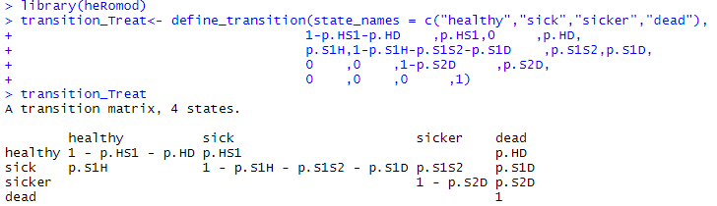
define_transition

Slide 48
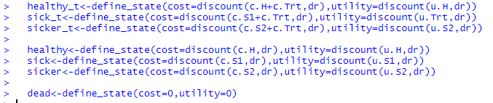
define_state

Slide 49
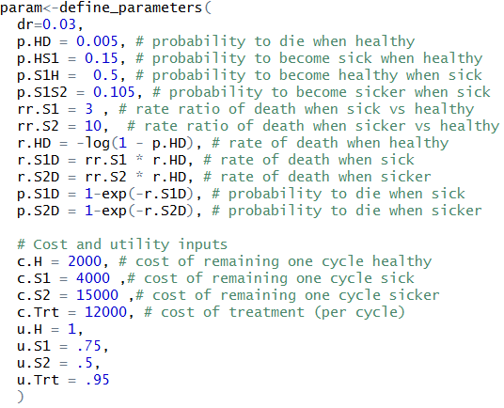
define_parameters
Parameter | No Treat | Treat
p.HS1 p.S1S2 p.S1H p.HDie p.S1Die p.S2Die | 0.15 0.105 0.5 0.005 0.01492512 0.04888987 | 0.15 0.105 0.5 0.005 0.01492512 0.04888987
cost.H cost.S1 cost.S2 | 2000 4000 15000 | 2000+12000 4000+12000 15000+12000
utility.H utility.S1 Utility.S2 | 1 0.75 0.5 | 1 0.95 0.5
Discount Rate | 3% | 3%

Slide 50
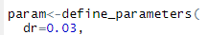
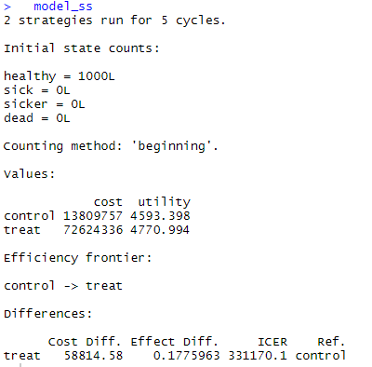
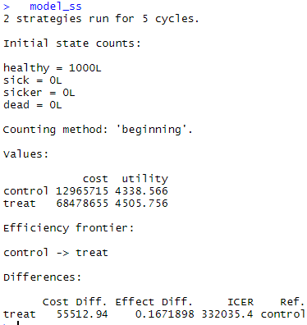
Run_model

Slide 51
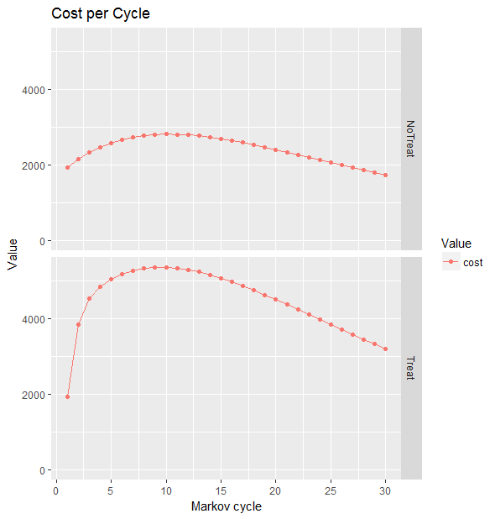
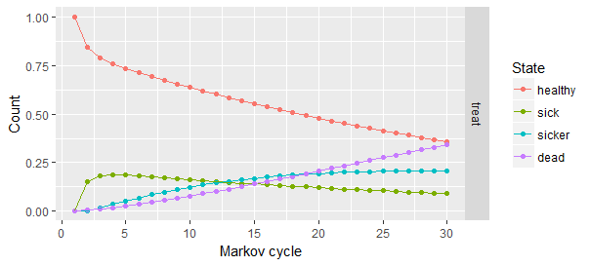
Built in Graphics

Slide 52
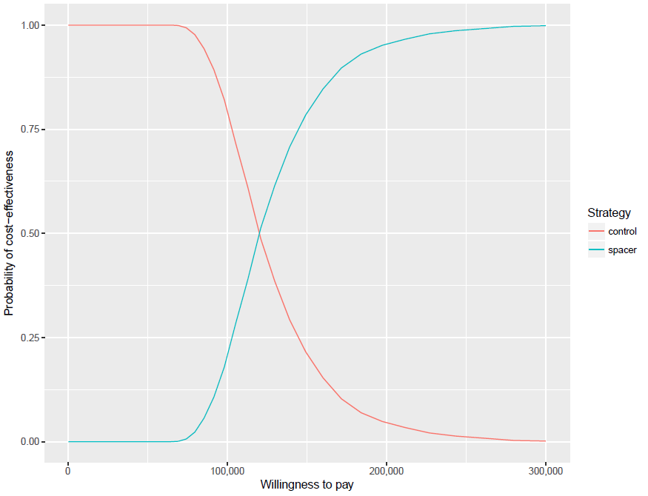
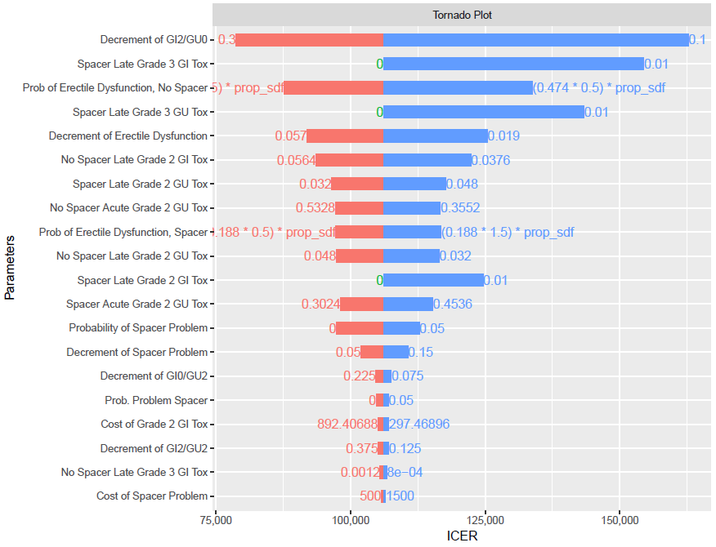
Built in Graphics

Slide 53
So why R?
One platform to do everything
Your problems are rarely unique
Easier to share and review
More complex analysis and microsimulation …..

Slide 54
Integrating statistical and economic models with hesim

Slide 55
Economic modeling
Economic models are constructed by combining statistical models for disease progression, costs, and utilities
The disease progression models simulate health state occupancy probabilities
The utility and cost models predict utility and costs in each health state
Uncertainty in the parameters from the statistical models is propagated throughout the economic model and decision analysis with probabilistic sensitivity analysis (PSA)
Supported economic models include N-state partitioned survival models (PSMs) and continuous time state transition models (CTSTMs)

Slide 56
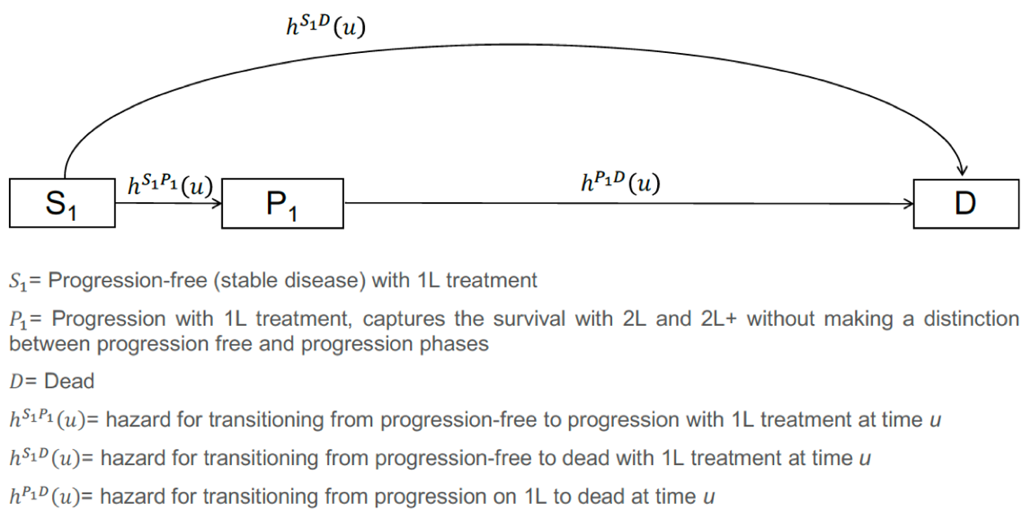
Example CTSTM in oncology (the IVI-NSCLC model)

Slide 57
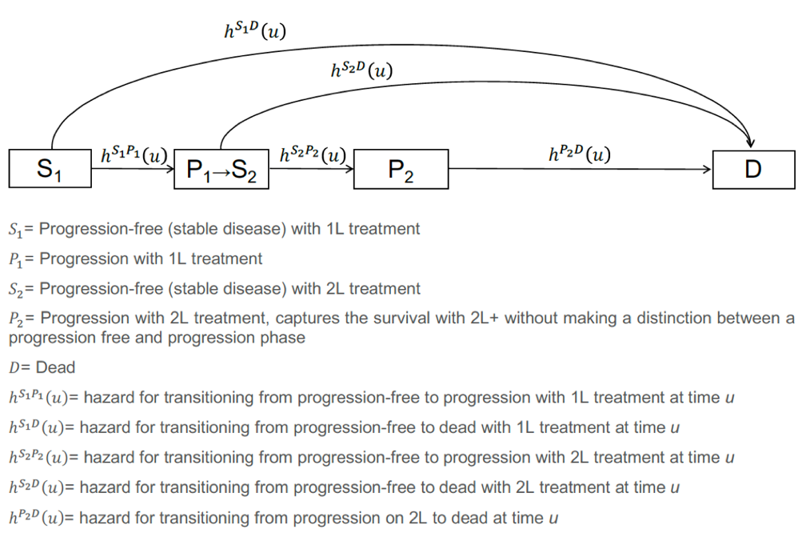
Expanding the standard 3-state oncology model to 4-states

Slide 58
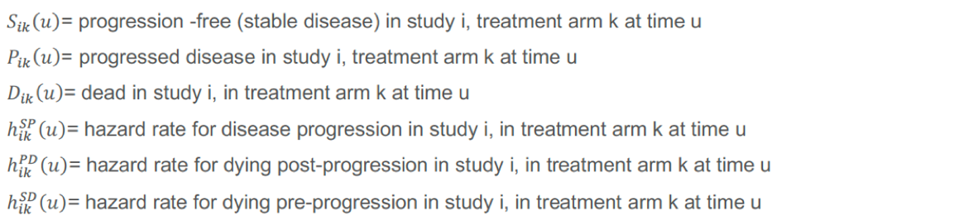
Parameterization using multi-state network meta-analysis conducted separately by line (1L, 2L)

Slide 59
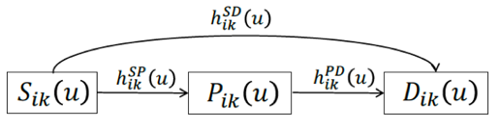
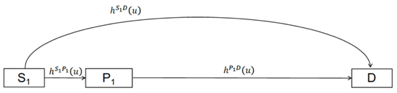
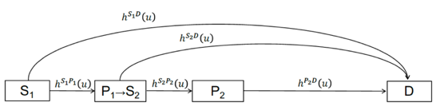
Integration of statistical and economic models
Evidence synthesis models
Simulation models

Slide 60
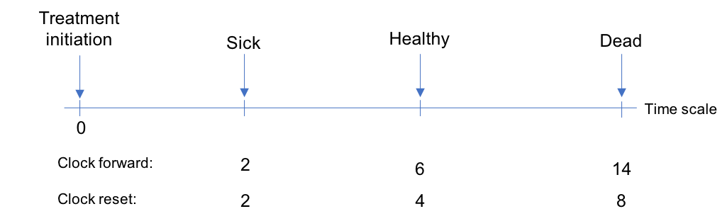
Time scales for multi-state models
Markov (i.e., “clock-forward”) implies that the hazard function is based on time since initiating 1L treatment
Semi-Markov (i.e., “clock-reset”) implies that the hazard function is based on time since entering each state
NMA is a “clock-forward” model
But time resets when entering S₂ in the 4–state model

Slide 61
Two methods for simulating multi-state models
Cohort simulation (Aalen-Johansen estimator)
Matrix version of the Kaplan-Meier estimator that can compute state occupancy probabilities
Only applicable to clock-forward models
Individual-level simulation
Simulate trajectories through multi-state model with random number generation for a large number of patients
Compute expected values by averaging over simulating patients
Applicable to both clock-forward and clock-reset models

Slide 62
Simulating a simplified 3-state NSCLC model with hesim using an individual-level simulation

Slide 63
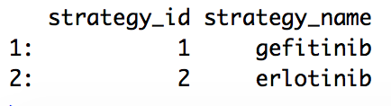
Treatment strategies
For simplicity, we will compare 2 treatment strategies
strategies <- data.table(strategy_id = 1:2,
strategy_name = c(“gefitinib”, “erlotinib”)
print(strategies)

Slide 64
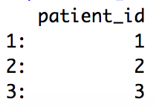
Target population
Economic evaluations are conducted for a target population of interest
Here we rely completely on summary-level RCT data so patients are identical (i.e., no covariates), but we will simulate 1,000 of them so that expected values are stable
patients <- data.table(patient_id = 1:1000)
patients[1:3]

Slide 65
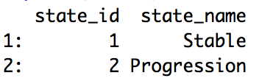
Model structure (health states)
The simplified NSCLC model has 3 health states, 2 of which are non-death states
states <- data.table(state_id = 1:2,
state_name = c(“Stable”, “Progression”)
print(states)

Slide 66
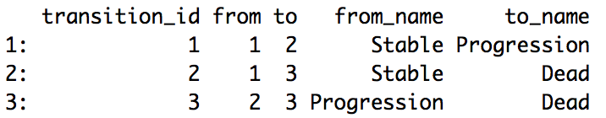
Model structure (health state transitions)
The model has 3 transitions, which are summarized with a transition table
tmat <- rbind(c(NA, 1, 2),
c(NA, NA, 3),
c(NA, NA, NA))
colnames(tmat) <- rownames(tmat) <- c(“Stable”, “Progression”, "Dead")
transitions <- create_trans_dt(tmat)
print(transitions)

Slide 67
hesim data
Information on the treatment strategies, target population, and model structure can be combined into a hesim_data object, which will later be used to create input data for the simulation
hesim_dat <- hesim_data(patients = patients,
strategies = strategies,
states = states,
transitions = transitions)

Slide 68
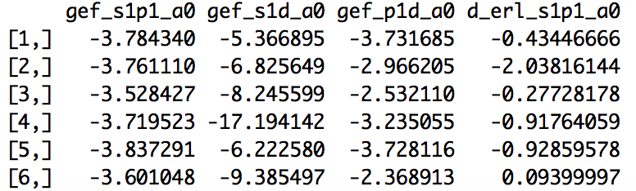
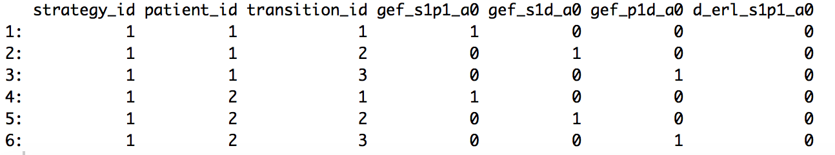
Constructing a model for health state transitions
The transition model consists of parameters from the multi-state (Weibull) NMA and input data used for prediction
transmod <- create_IndivCtstmTrans(object = params_mstate_nma_wei,
input_data = transmod_data,
trans_mat = tmat,
clock = "forward")
Parameters
Input data
Note: The Weibull distribution used for the NMA is a reparameterization of the standard Weibull distribution that depends on 2 parameters, a₀ and a₁, which are functions of the standard shape and scale parameters

Slide 69
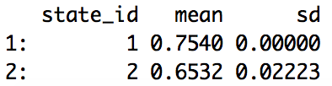
Constructing models for costs and utilities
The easiest way to model utilities and costs is from a stateval_tbl
utility_tbl <- stateval_tbl(data.table(state_id = 1:2,
mean = c(0.7540, 0.6532),
sd = c(0, 0.02223000)),
dist = "norm",
hesim_data = hesim_dat)
print(utility_tbl)
Which are, in turn, used to construct a “state values” model
utilitymod <- create_StateVals(utility_tbl, n = 1000)

Slide 70
Creating an economic model by adding costs and utility models
The CTSTM is constructed by combing the transition, utility, and cost models
econmod <- IndivCtstm$new(trans_model = transmod,
utility_model = utilitymod,
cost_models = costmods)

Slide 71
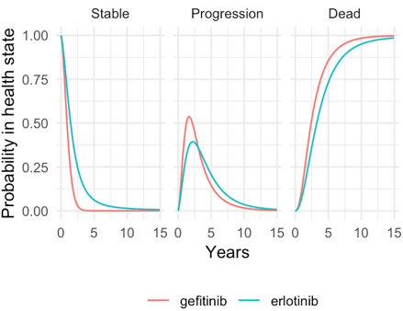
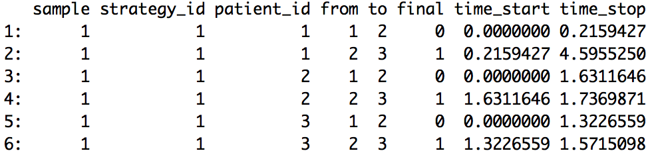
Simulating health state transitions
In the individual-level CTSTM, unique trajectories through the multi-state model are simulated for each patient, treatment strategy, and PSA sample
econmod$sim_disease()
econmod$sim_stateprobs(t = seq(0, 20 , 1/26))
Disease progression
State probabilities

Slide 72
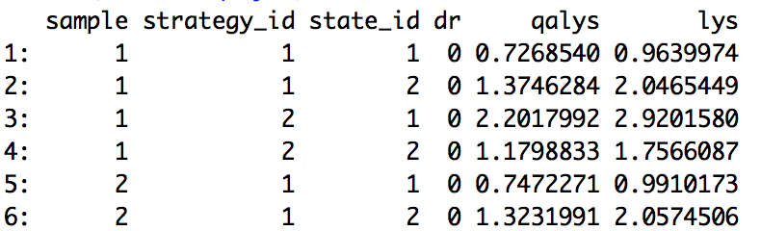
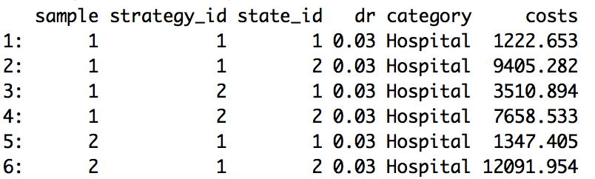
Simulating QALYs and costs
By default, mean QALYs and costs are simulated by treatment strategy, patient, health state, and PSA sample
econmod$sim_qalys(dr = c(0, .03))
econmod$sim_costs(dr = .03)
QALYs
Costs

Slide 73
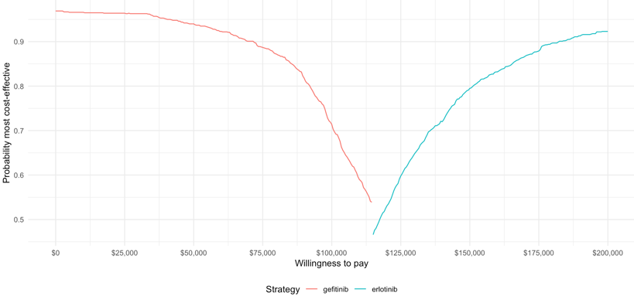
Cost-effectiveness analysis
Summaries of costs and QALYs (i.e., estimates by treatment strategy and PSA sample) are used to perform a (potentially “individualized”) CEA
ce_sim <- econmod$summarize()
icea_out <- icea(ce_sim, dr_qalys = .03, dr_costs = .03)
icea_pw_out <- icea_pw(ce_sim, comparator = 1, dr_qalys = .03, dr_costs = .03)
Cost-effectiveness acceptability frontier

Slide 74
So why R?
A comprehensive ecosystem for fitting statistical models
Computational efficiency
Reproducible research
Web apps
Unit testing

Slide 75
Resources
hesim
https://github.com/hesim-dev/hesim
https://github.com/hesim-dev/hesim-presentations
IVI-NSCLC model
https://innovationvalueinitiative.github.io/IVI-NSCLC/

Slide 76
Live Content Slide
When playing as a slideshow, this slide will display live content
Poll: Do you think R is better for cost-effectiveness modeling and analysis than Excel?
Notes:
This is a live content slide. When playing this presentation as a slideshow, this slide will be where live content appears. Please leave the following Slide Code tag in place: <cnf>DF1GGNBX6C8KPS74</cnf>

Slide 77
Live Content Slide
When playing as a slideshow, this slide will display live content
Pre/Post Comparison: Do you think R is better for cost-effectiveness modeling and analysis than Excel?
Notes:
This is a live content slide. When playing this presentation as a slideshow, this slide will be where live content appears. Please leave the following Slide Code tag in place: <cnf>KJKQYGN1E2TEKTHP</cnf>

